Slide 1
Building Price Models

Slide 2
Price Prediction
Bayesian classifiers, decision trees, SVMs are not best for making predictions on numerical data
  Such as prices
Price prediction are a good case of collective intelligence
  Many buyers, many sellers on transactions
  The price usually reach optimal for both sides
Determining which variables(attributes) are important and in what combinations
  Use optimization techniques!

Slide 3
Wine Prices: Artificial Dataset
The prices are based on a combination of the rating and the age of the wine
The model assumes that wine has a peak age, which is older for good wines and almost immediate for bad wines
A high-rated wine will start at a high price and increase in value until its peak age, and a low-rated wine will start cheap and get cheaper

Slide 4
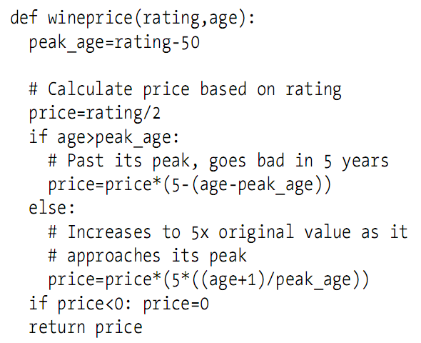
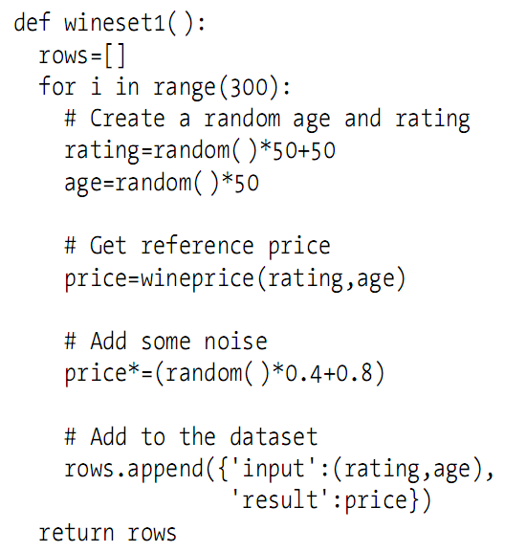
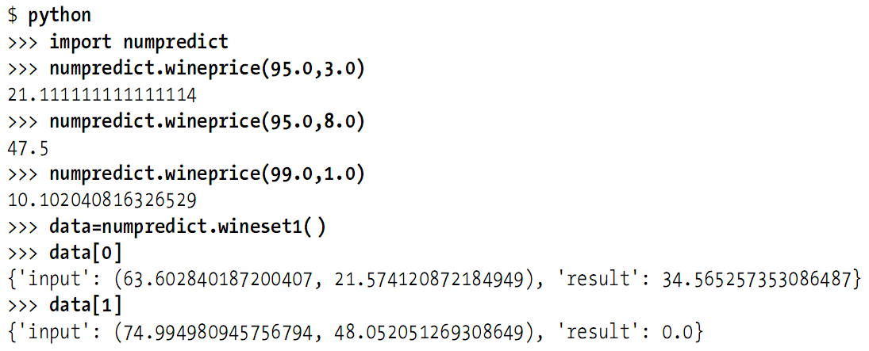
Wine Price Function

Slide 5
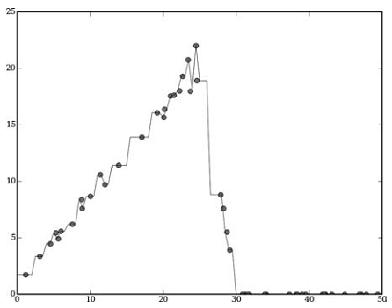
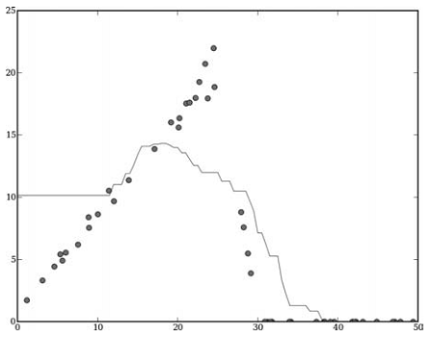
Easiest Approach: kNN
Find a few of the most similar items and assume the prices will be roughly the same
Problem visualization

Slide 6
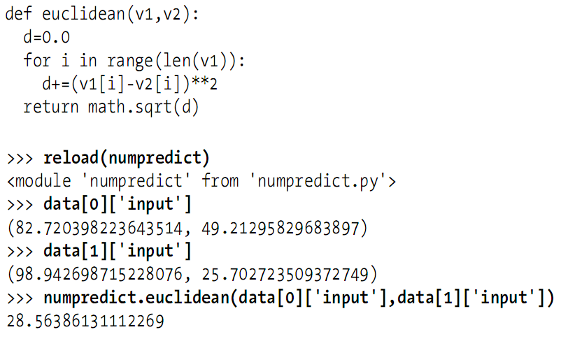
Similarity: Eucledian?
Problem: some of variables have a greater impact on the final price than others, how?

Slide 7
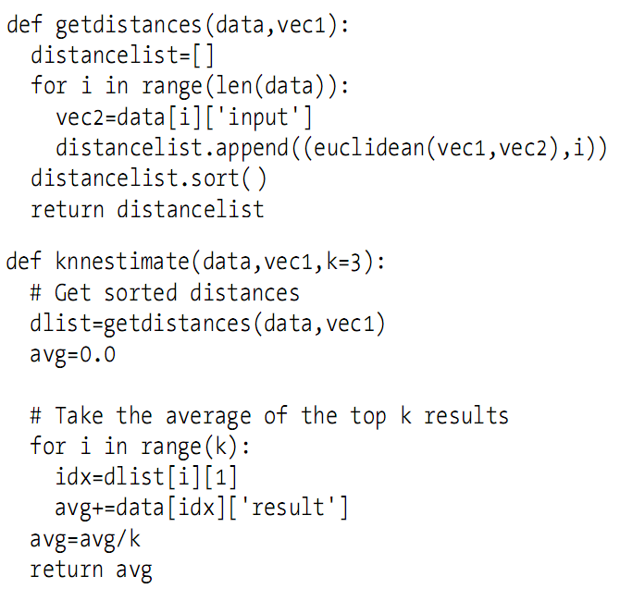
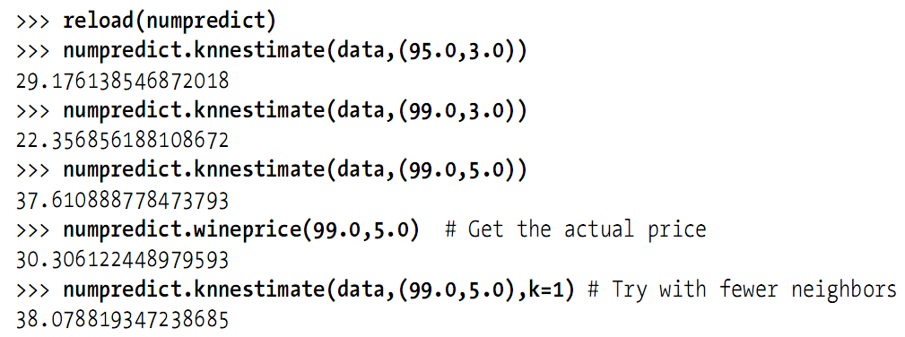
kNN Code

Slide 8
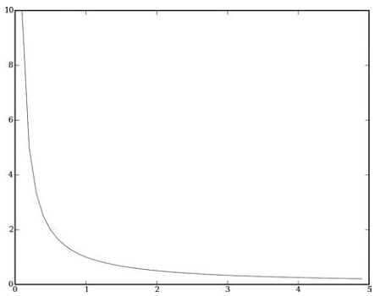

Weighted Neighbors
Similar to movie recommendation
  People’s preferences were weighted
Convert distance to weight: inverse function
  add a small number to the distance to avoid very high or infinite weight

Slide 9
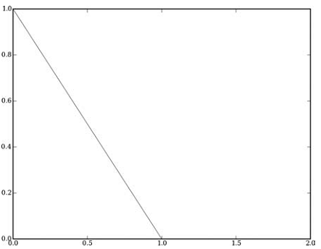
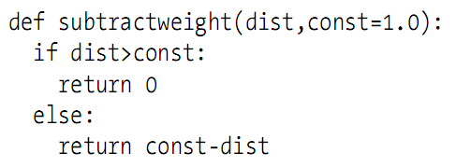
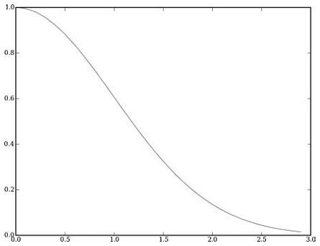

Weighted Neighbors
Convert distance to weight: subtraction function
Convert distance to weight: Gaussian function

Slide 10
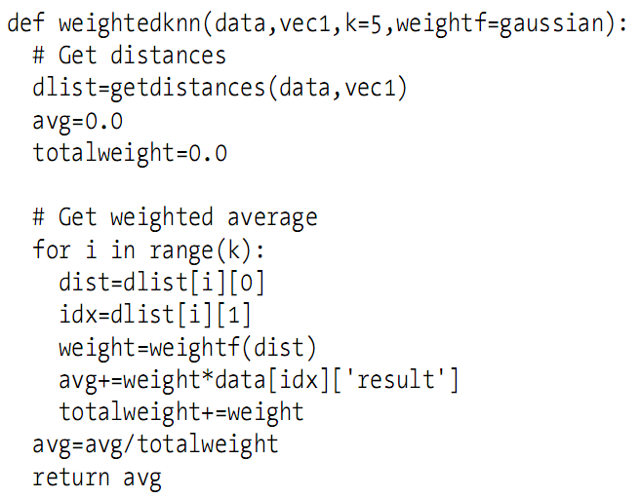
Weighted kNN

Slide 11
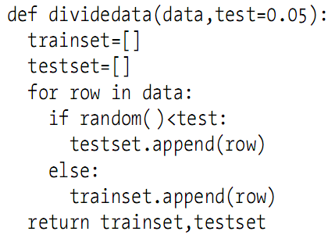
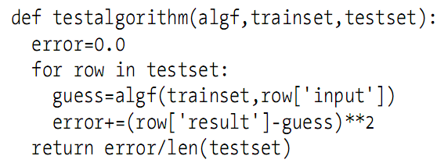
Cross-Validation
Technique to divide up dataset into training sets and test sets
Usually perform several times, dividing the data up differently each time
Typically, the test set will be a small portion, perhaps 5% of the data

Slide 12
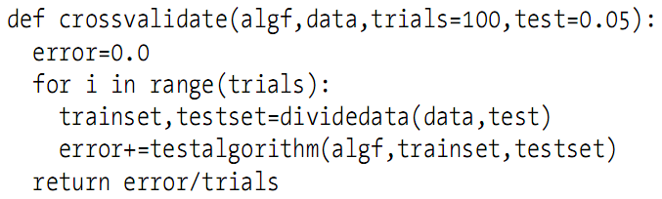
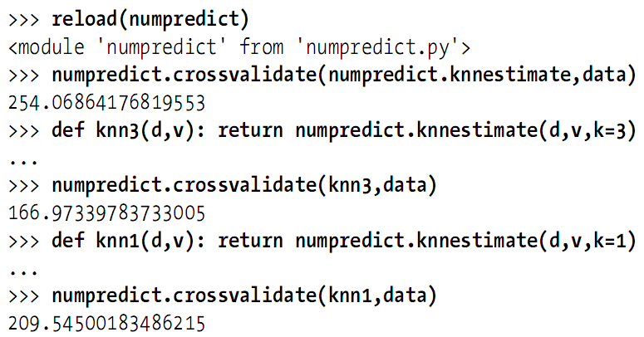
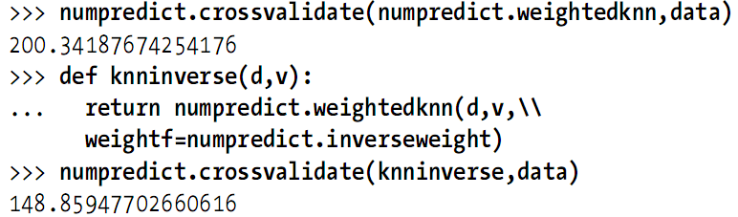
Cross-Validation
With different tests: k value, weight function

Slide 13
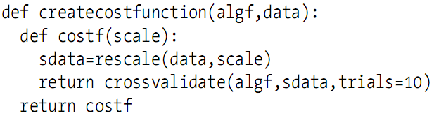
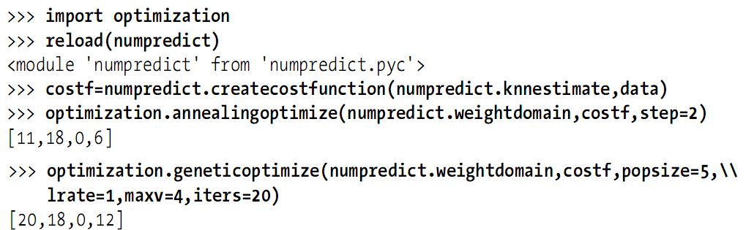
Heterogeneous Variables
Different variable may have different range
Scaling dimension is necessary
  Scale parameter should be optimized

Slide 14
Uneven Distribution
There may be an unmeasured variable that can have a big effect on the outcome
  E.g. two separate groups of wine buyers: people who bought from the liquor store, and people who bought from a discount store and received a 50% discount
Estimating the Probability Density
  Just get a single price estimate? No.
  It might be interesting to know the probability that an item falls within a certain price range
  E.g. 50% chance that the price is $40~$80, and a 50% chance between $80~$100

Slide 15
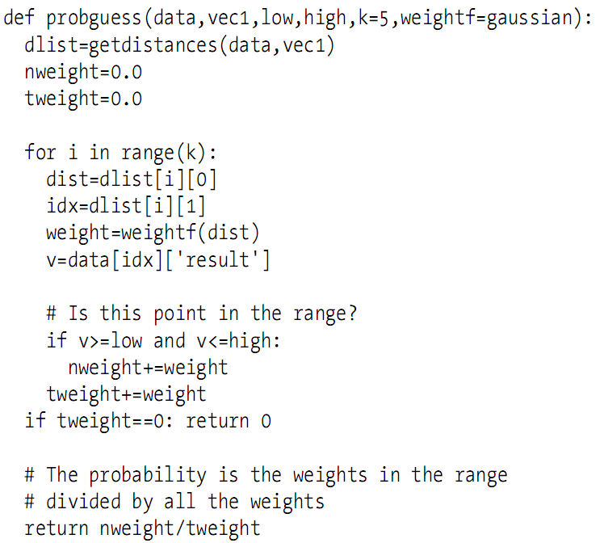
Guess Probability
The probability is the sum of the neighbor weights within the range divided by the sum of all the weights

Slide 16
Example: eBay Price Predictor
Help yourself

Slide 17
Summary
Disadvantages of kNN
  Making predictions is very computationally intensive
  Determine the appropriate weights for variables is difficult
    Optimization can help, but also computationally intensive
Advantages of kNN
  Finding weights gives understanding of the dataset

